Slide 1
Preparing for the Eclipse: a Mass Gathering Event
James R. “Bob” McKee, MBA, D.Sc.(c)
August 2017

Slide 2



Housekeeping
Recording of the video
A copy of the slides
Resources
Notes:
We will provide a recording of today’s webinar, a copy of the slides and other resources for you in the next few days

Slide 3
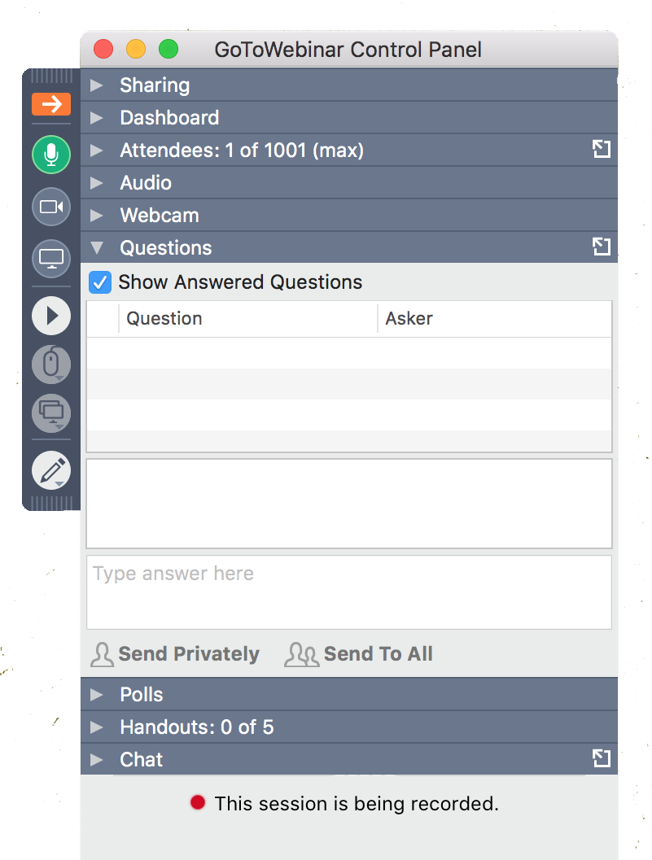

Housekeeping
Ask questions throughout the webinar
We’ll do Q&A at the end
Type Here
@EBHealthcare

Slide 4
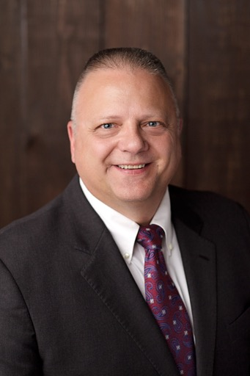
Our Speaker
J. Robert “Bob” McKee, D.Sc.(c), M.B.A. Boston University HEM
Bob has over 30 years of experience in Fire/EMS, Emergency Management, Disaster Preparedness and Crisis Planning. He has worked at the local, state, federal and international government levels in emergency response and crisis management.
He was Agency Chief for Texas Task Force One Urban Search and Rescue, and the ESF-9 Director of the State of Texas. In addition, responding to State and Federal incidents for the Federal Emergency Management Agency (FEMA), serving on the DHS/FEMA Incident Management Team. He served as a Division Director at Texas A&M University overseeing the development and training of Disaster City for worldwide participants.
Bob served as Fire Chief and Paramedic for Mad River Fire Department in Ohio. He has been deployed on numerous State and Federal disaster response teams including the World Trade Center on 9/11, Space Shuttle Columbia Disaster, Hurricane Katrina and Hurricane Ike, and the Haiti Earthquake Response to highlight just a few.

Slide 5
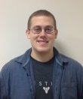
Our Speaker
Chris Brooks, Ph.D. Candidate at BU Medical School
Chris Brooks is a PhD Student in the Anatomy and Neurobiology Doctoral Program, and has been a part of the laboratory for Human Neurobiology at Boston University since February 2014. Chris is interested in the neurobiological foundations of learning, specifically how neuroscience can be used to inform improvements in the policies of secondary and higher education. Currently, Chris is working on projects involving Parkinson's disease and quantifying motor movements. In addition to his studies, Chris is active in environmental areas such as meteorology and space weather, particularly the upcoming solar eclipse.

Slide 6
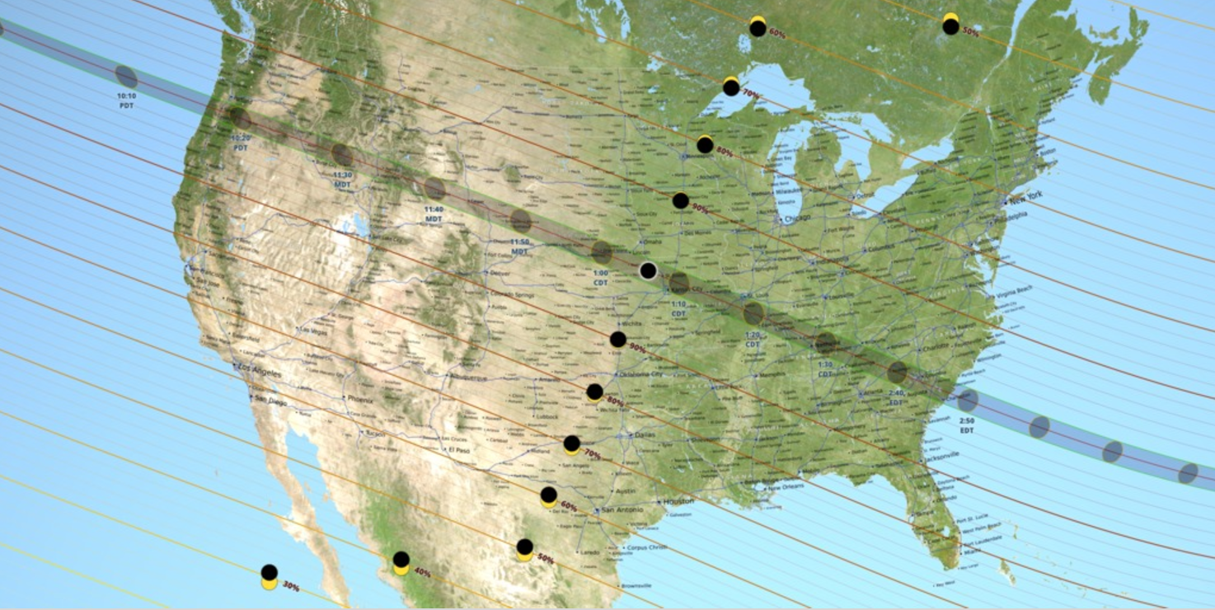
Eclipse 2017
10:18
am PT
7 Million Visitors Moving into the Path of Totality
Near night time conditions in the sky, some stars will be visible
Visitors may change their original plans if weather obstructs the view
Communities should plan for a 4-day event as visitors come into an area and depart after the event
2:45 pm ET
Time to Travel Across U.S.
1 Hour, 27 Minutes

Slide 7
POLL QUESTION
How close are you to the Path of Totality?
  We’re on the Path of Totality
  We are within 50 miles of the Path of Totality
  We are more than 50 miles from the Path of Totality

Slide 8
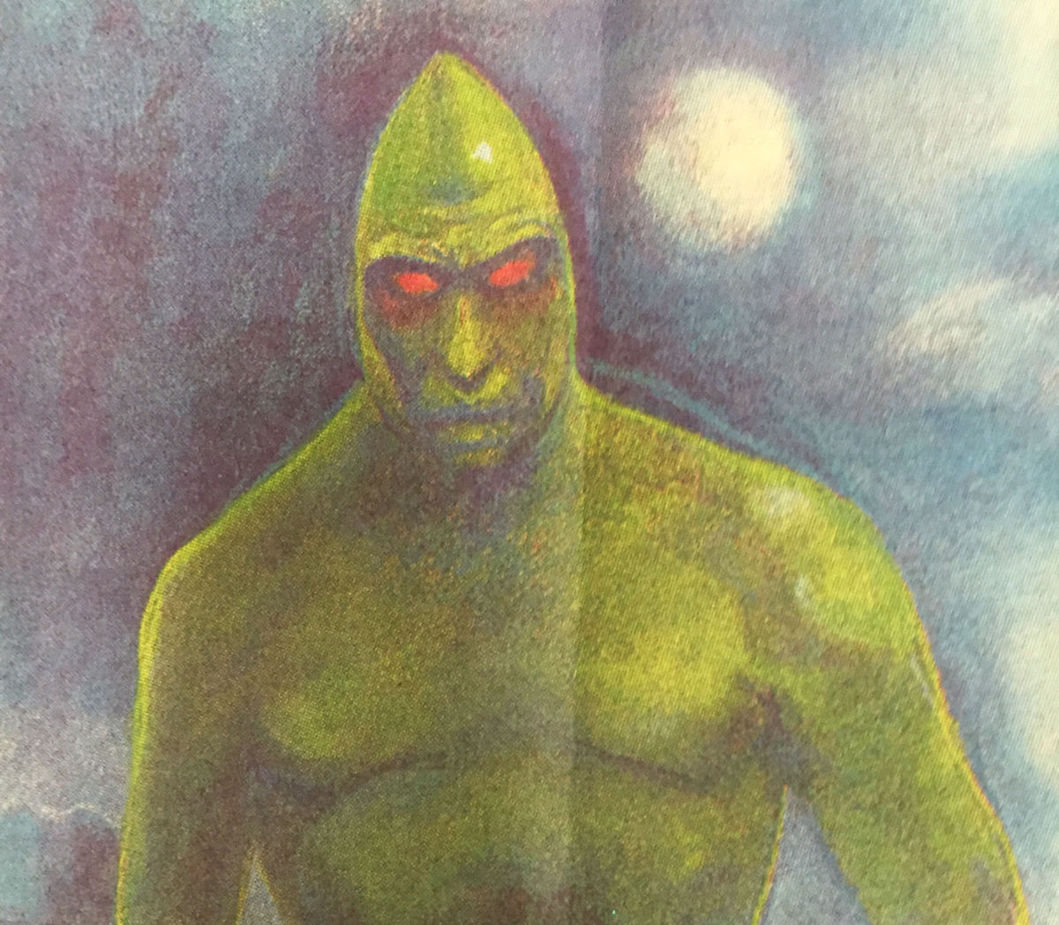
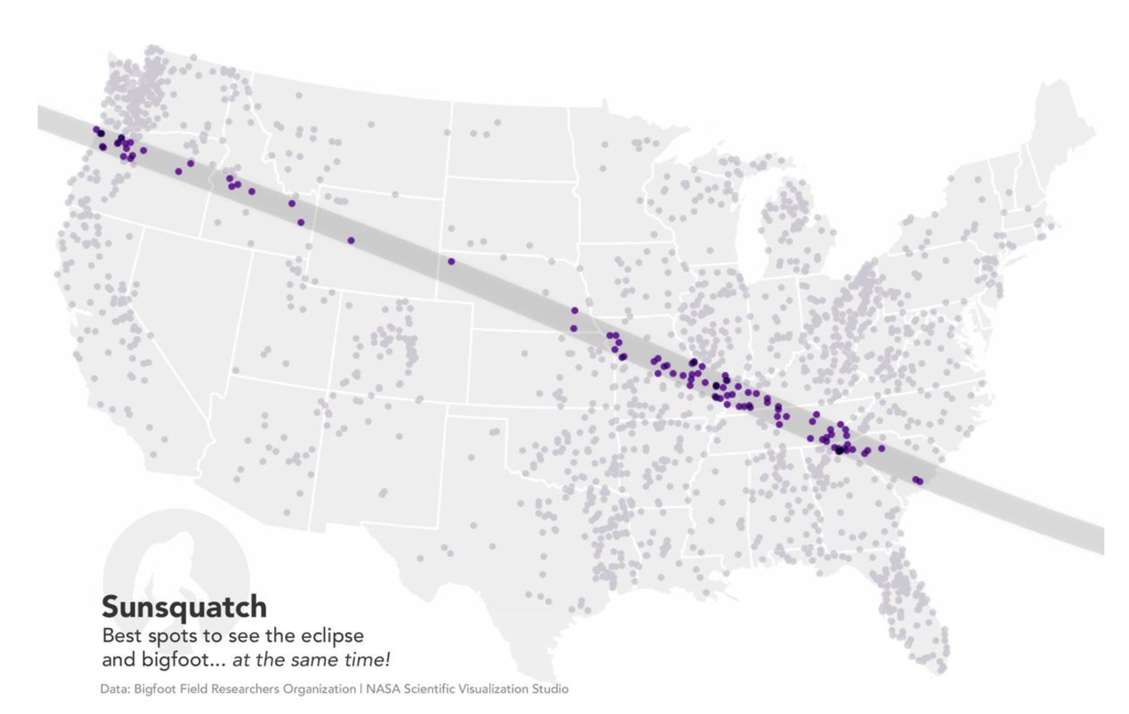
Communities Need a Soup to Nuts Approach
Communities aren’t just thinking about traffic and parking, they are also planning:
Hospitals ED surges due to car accidents, drug and alcohol use, and minor injuries while reaching viewing places
Resources for visitors like water and port-a-potties
Weather shifts like drops in temperature by up to 10°F and wind gusts
How to talk to the press if an incident occurs
Coordinating with county, state, and other government agencies if additional assistance is required
And yes, possible Lizard Man sightings – maybe Big Foot too
Notes:
Source for Lizard Man & Big Foot: http://www.postandcourier.com/news/agencies-advise-on-possible-lizard-man-bigfoot-sightings-in-south/article_2388dc18-7d26-11e7-8ad8-33c9facf5e5f.html
Map of Sasquatch used in Lizard Man story, but original source is from NASA (really)

Slide 9

Definition of a Mass Gathering
FEMA defines a mass gathering as:
  a non-routine activity within a community that brings together a large number of people. Emphasis is not placed on the total number of people attending but rather the impact on the community’s ability to respond to a large-scale emergency or disaster or the exceptional demands that the activity places on response services. A community’s special event requires additional planning, preparedness, and mitigation efforts of local emergency response and public safety agencies.
Notes:
Definition from: https://training.fema.gov/emiweb/downloads/is15aspecialeventsplanning-jamanual.pdf

Slide 10
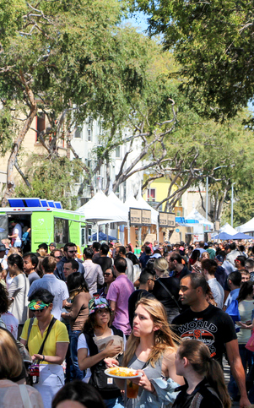
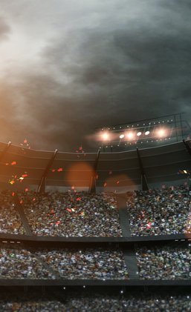
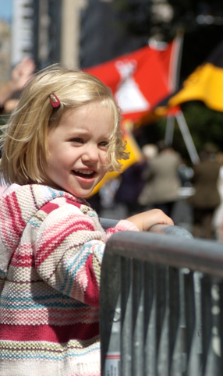
Types of Mass Gatherings
Notes:
Examples of Mass Gatherings
Large sporting events like the Super Bowl
Festivals
Parades
Conventions
Special events like the Inauguration
Link for FEMA/ASPR Tracie https://asprtracie.hhs.gov/technical-resources/85/mass-gatherings-special-events/27

Slide 11
POLL QUESTION
What is the biggest concern for your community around the Eclipse?
  Traffic Crowd control in my municipality
  Having enough staff to cover needs during the event
  Supply shortages such as water, medical supplies, or port-a-potties
  Post-event movement of tourists

Slide 12
Expected Areas of Impact / Stress

Slide 13
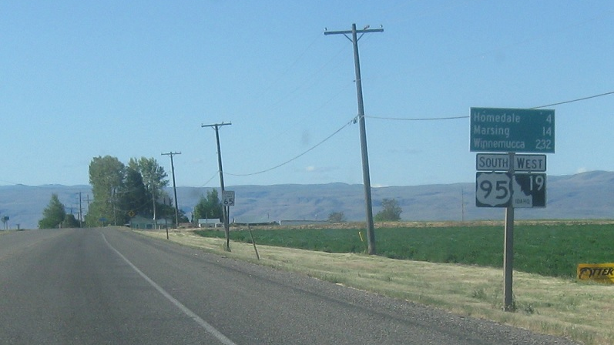
Transportation networks
(congestion including total stop)
  Highways
  Local Roads
  Bikes and Footpaths
Notes:
Picture source: http://corcohighways.org/?p=585

Slide 14
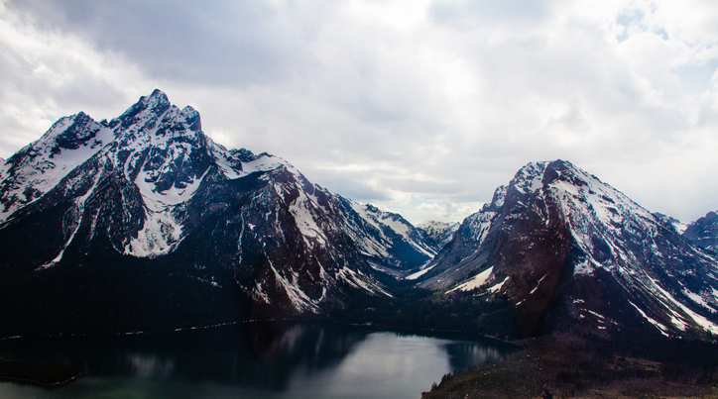
Areas with Long Sight Lines
  Mountains
  Building Roofs
  Remote Areas
  Local & State Parks
  Shorelines

Slide 15
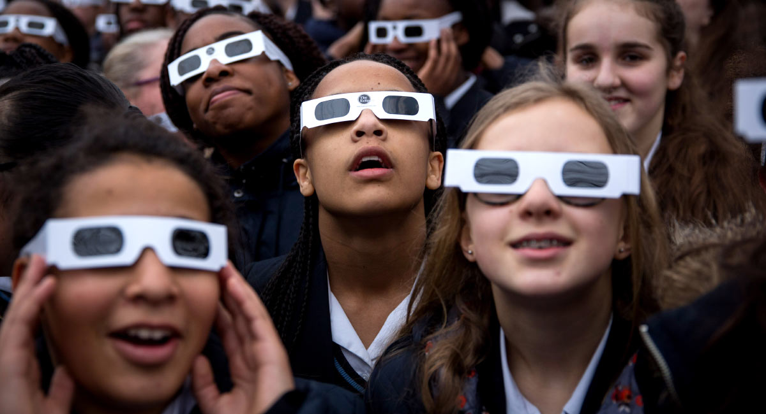
Educational Facilities
School closures or early release
Some universities are planning special observational events
Notes:
School closures or early release
Some universities are planning special observation events
Photocredit: https://www.fatherly.com/gear/companies-are-selling-fake-solar-eclipse-sunglasses/

Slide 16
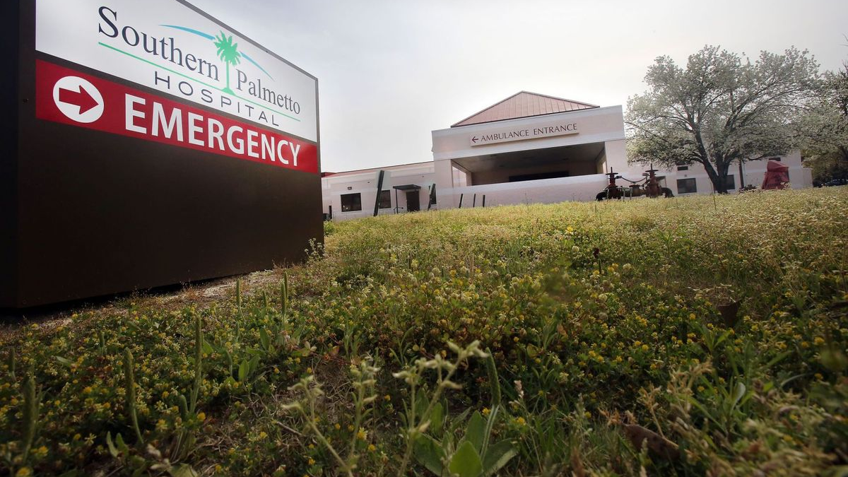
Hospital ED Surge
Car accidents
Twisted ankles & other minor injuries to reach viewing area
Eye injuries from inappropriate viewing
Heat stroke / dehydration
Notes:
Picture credit http://www.postandcourier.com/archives/barnwell-other-towns-face-new-reality-after-rural-hospitals-close/article_6aeb6fda-298d-5b3f-b0c9-c5966c250f36.html

Slide 17
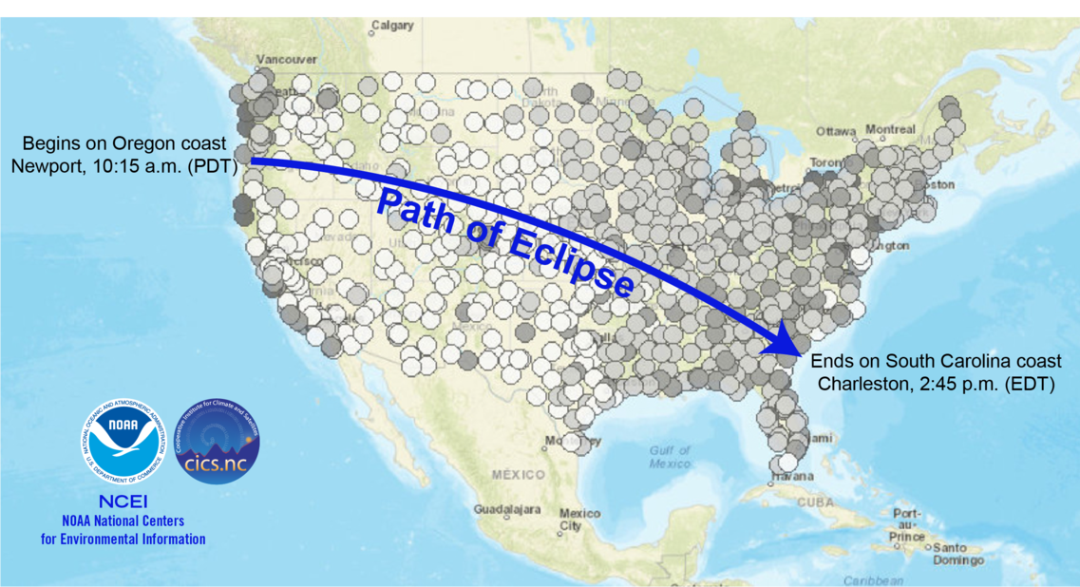
Weather may affect last-minute travel to viewing sites.
Notes:
Map source: NOAA https://www.weather.gov/images/iln/Eclipse/eclipsemap_clouds.png

Slide 18
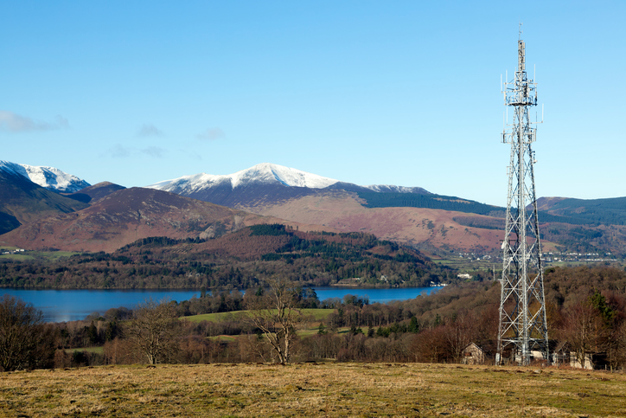
Increased visitors
+ special event
Mobile Communication Issues
Notes:
Do you have a backup plan

Slide 19
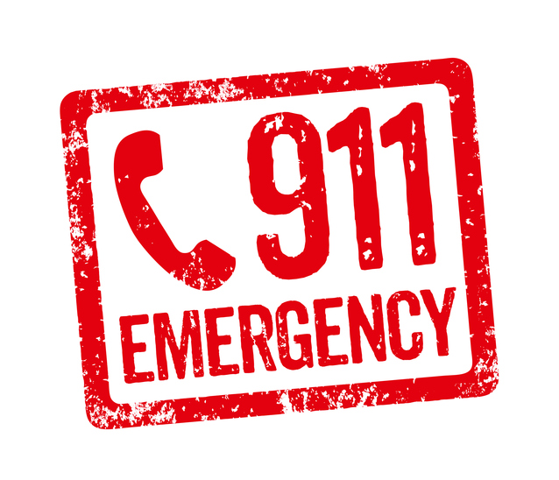
911 Calls and EMS Needs Increase
  Traffic control issues
  Motor vehicle accidents
  Power support issues
  EMS deployed to high viewing areas
  Mobile communications might be a problem

Slide 20
10 Steps
To Review and Upgrade your Current Plans

Slide 21
Assess Projected Local Impact
1
Traffic before, during, and after the event
Parking needs
Viewer influx at prime watch spots
Resources for viewers such as access to restrooms and water

Slide 22
Asses & Plan for Additional Staffing
2
Police
Fire
Local medical responders
Local government officials
Media/Press relations

Slide 23
Confirm Your Recall Procedures for Off-Duty Staff
3
How will you activate additional staff if needed?
  Email
  SMS messaging
  Phone Tree
  Do you have an escalation plan in place if staff don’t or can’t respond?
  Other ways to communicate, especially if mobile communications are overloaded?

Slide 24
Plan for Surge in Calls for Assistance (911 & General Inquiries)
4
Mobile carriers are expecting heavy usage during the eclipse – be prepared with alternate means of communication
Some carriers are positioning temporary mobile towers to assist with the volume, check carriers in your area to see if they are providing additional service

Slide 25
Plan for Traffic Congestion Alternatives
5
Know how you will convey traffic issues to your emergency responders for quick response
Have signage and other ways to signal visitors if traffic patterns are changing

Slide 26
Review Continuity of Operations Plan (COOP) & Emergency Op Plans
6
Consider activating a Command Center during the event to ensure continuity
Consider having responders from other agencies as part of the command center to help speed communication and execution

Slide 27
Enact or Create Internal Communication Protocols
7
Consider checklists to ensure all critical tasks are completed
Consider how to escalate a task if it’s not completed in a timely manner

Slide 28
Enact or Create External Communication Protocol
8
Consider creating contact groups to reach the right people with the right information
Consider setting up a press area for local media

Slide 29
Coordinate Planning with Local Organizations
9
Consider working with local organizations like schools, hospitals, partner organizations and communities
Consider the local business community and if they need resources or help communicating with their employees
Consider other authorities such as public safety, public works, and utilities

Slide 30
Assess & Document Your Planning & Response Activities
10
You should track and record all activity during the event for lessons learned for future mass gathering events
Look for ways you can improve future responses
Look for ways to improve tabletop and active drills going forward
Notes:
After action report

Slide 31
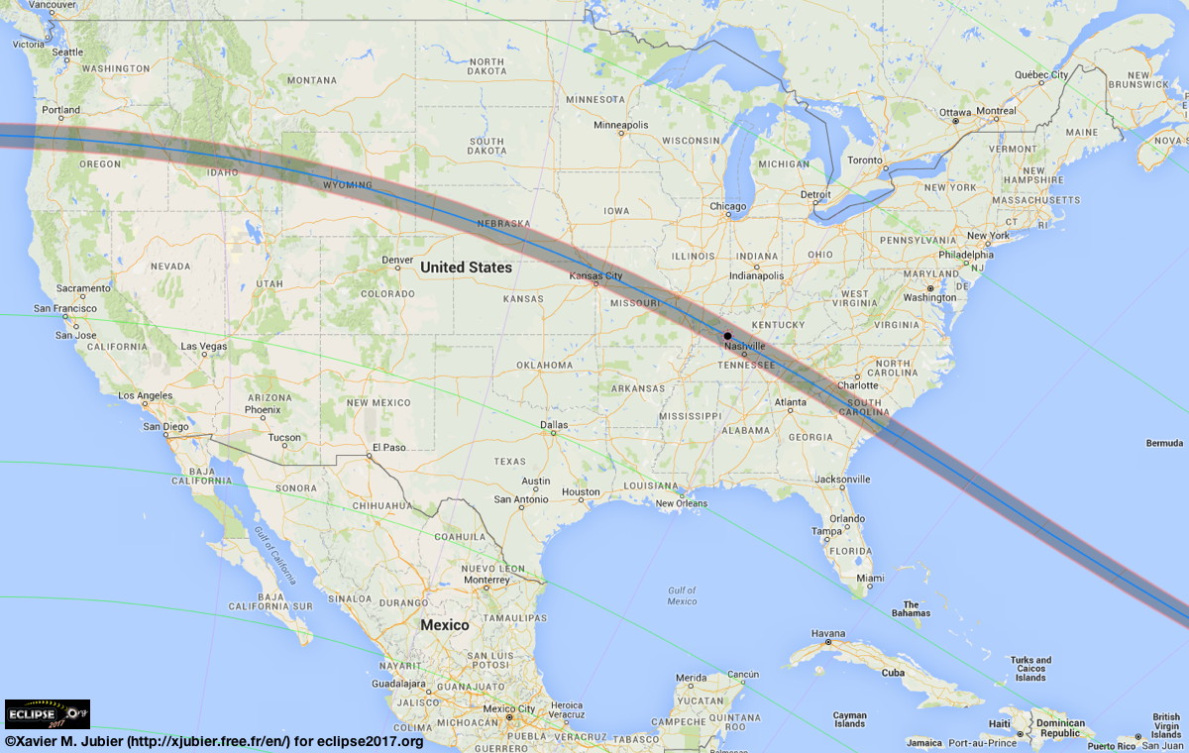
500,000 to 3 Million Visitors will
travel through Larimer County, CO
on the way to the Eclipse
Notes:
Population of Larimer County is 333,577 (most recent census)

Slide 32
Linc4Eclipse
Eclipse
888777
Eclipse2017

Slide 33
Questions

Slide 34

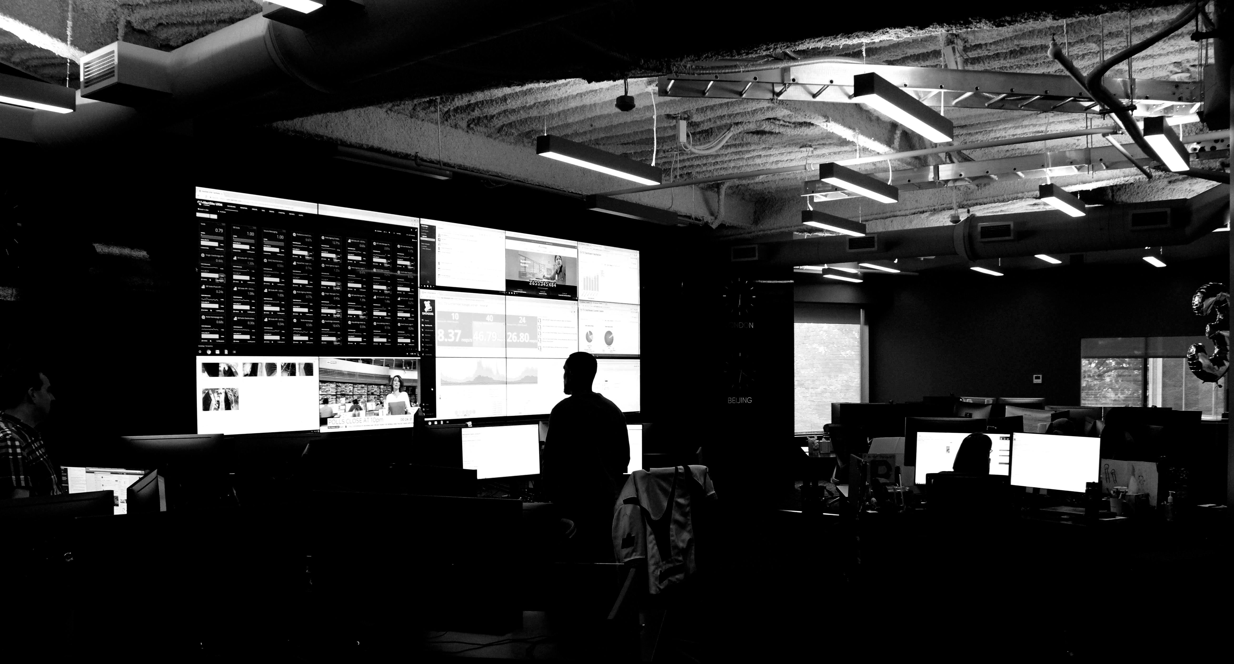
Questions / Contact Us
CLIENTS ONLY: Emergency Live Operator Service
877-220-4911 / 818-230-9797
FOR EVERYONE: Resource Guide for Eclipse Emergency Planning
http://go.everbridge.com/Eclipse2017Guide_RegistrationPage.html
everbridge.com | 781-373-9800| Lisa.Johnson@everbridge.com
Notes:
The 866 number is the Live Technical Support number for assistance with things like setting up a template or a contact group.
The Live Operator number is if you need assistance during an incident. We will deploy the messages for you, if needed.

Slide 35
Housekeeping
Recording of the video
A copy of the slides
Resources
Notes:
We will provide a recording of today’s webinar, a copy of the slides and other resources for you in the next few days

Slide 36
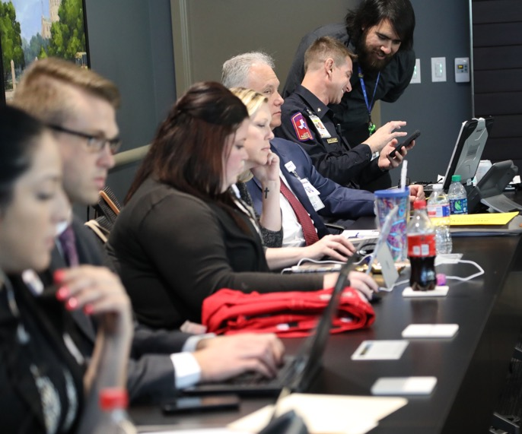

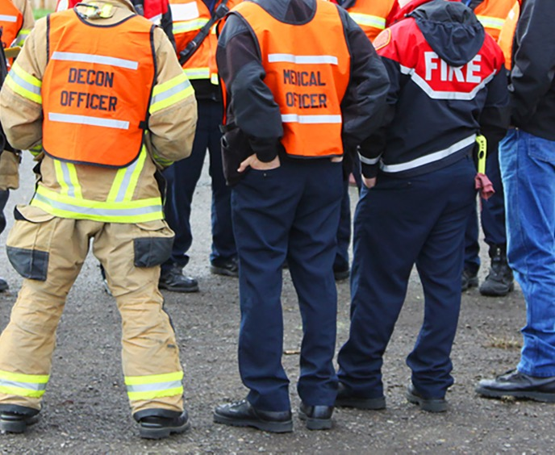

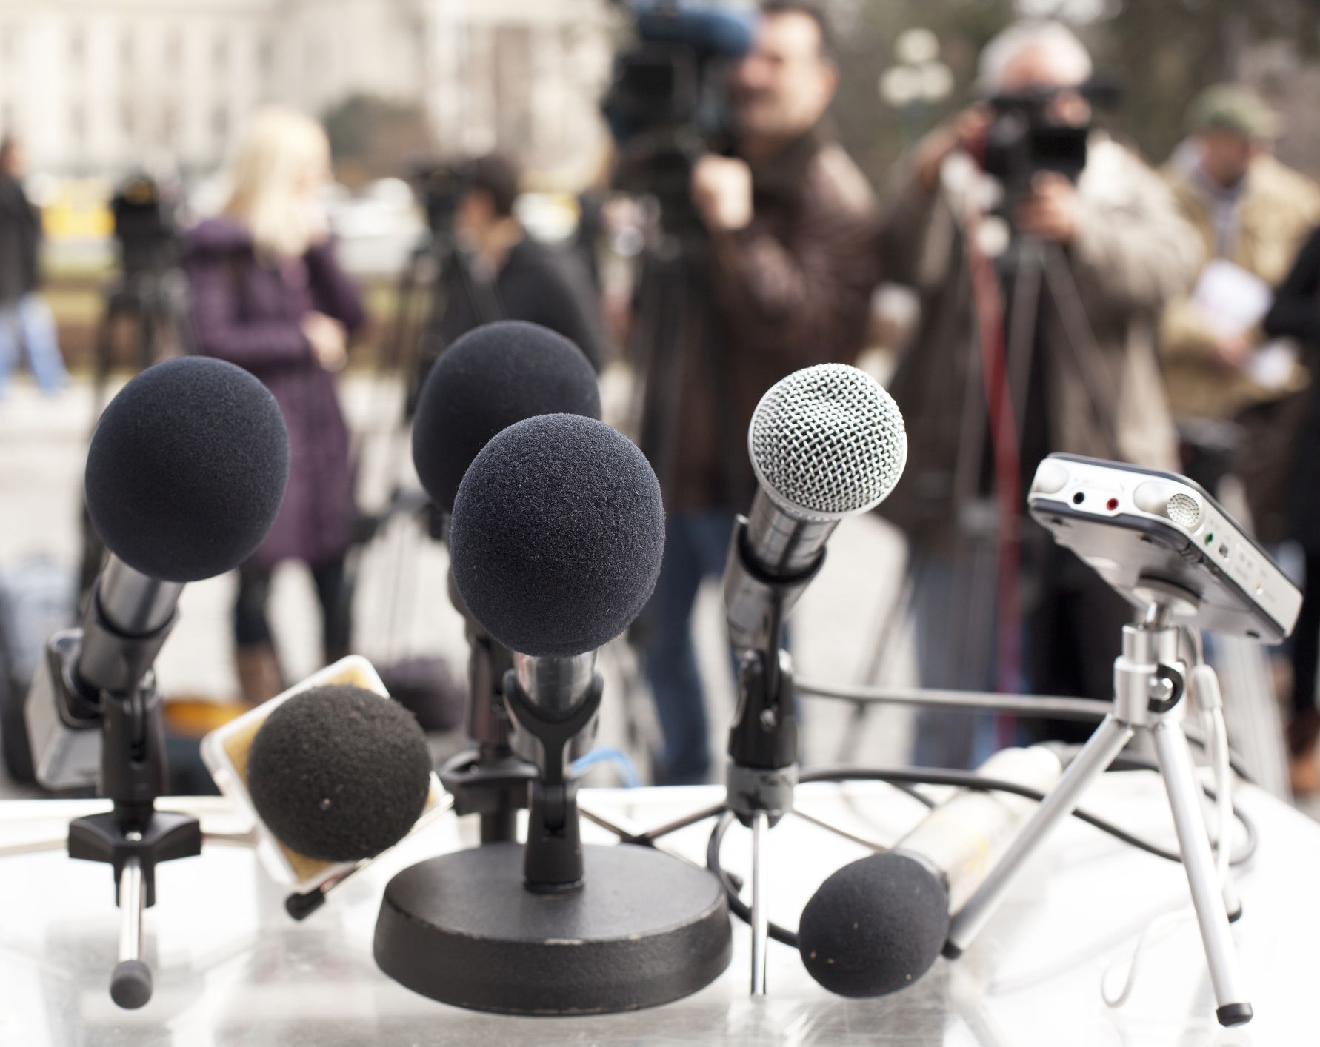
How Everbridge Helps You
Notes:
Everbridge helps you Assess, Locate, Act, Communicate, Analyze
Help you run your command center with checklists, our CMS Bundle of templates and more
Our software helps with CMS but other things too such as FEMA-grade reliability and can be deployed anywhere
We can help your coordinate with outside responders such as police, fire, EMT crews and critical vendors
Don’t forget about the local population, different languages, different social mores, different ways to contact them
Our CMS Emergency Preparedness Library has lots more information including a breakdown by the 17 different types of facilities for what you specifically need to do
Are you ready for the press if something occurs?

